Slide 1
Software Testing and Quality Assurance
Shubham Sharma 7001

Slide 2
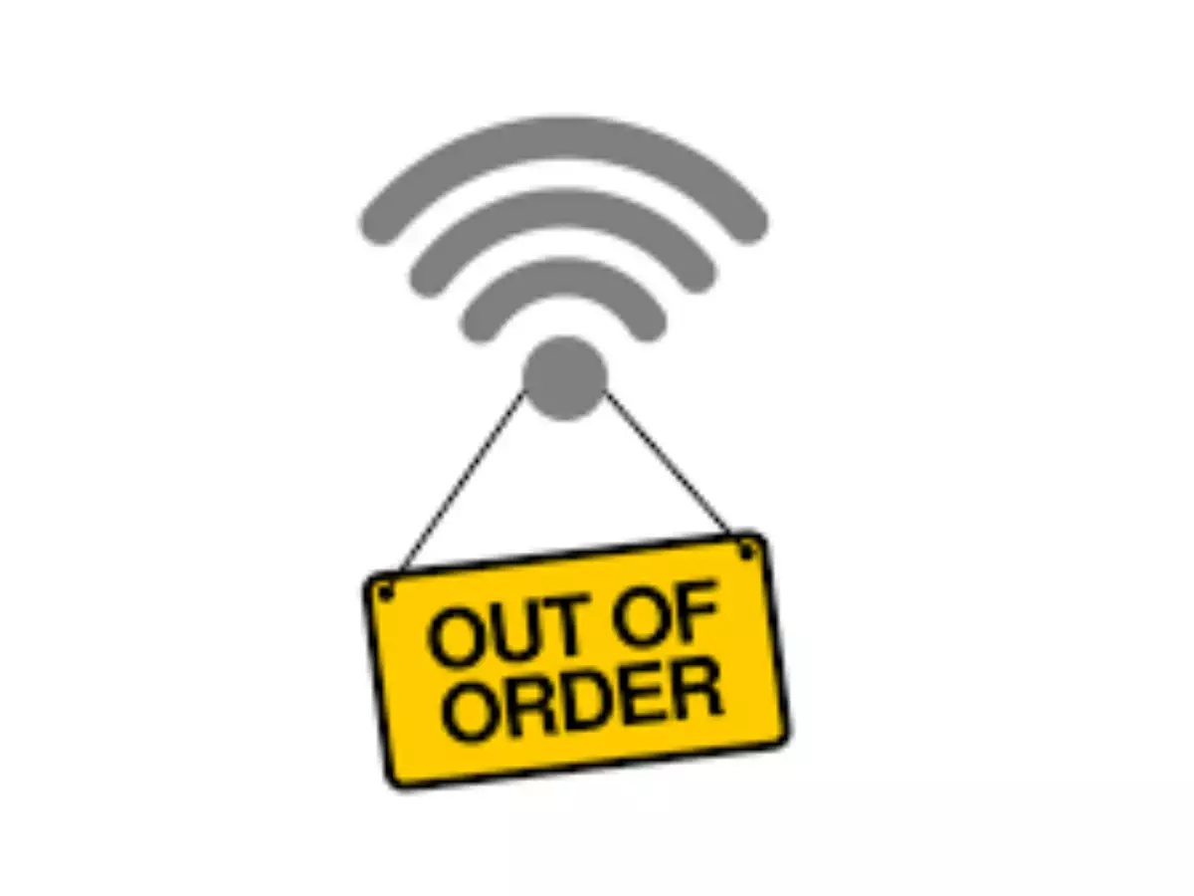

AT&T 1990 Network Collapse
Entire AT&T (American Telephone and Telegraph Company) network went down for 9 hours in 1990 due to a software bug.
Losses: About 75 million phone calls were missed, 200 thousand airline reservations lost. AT&T which advertised a lot about their reliability suffered huge financial losses and questions were raised on reliability of their network.
Cause: Buggy code in a complex software (for the network switches) upgrade implemented to speed up calling caused the shut down of network.
Fix: They reloaded the previous software version.

Slide 3
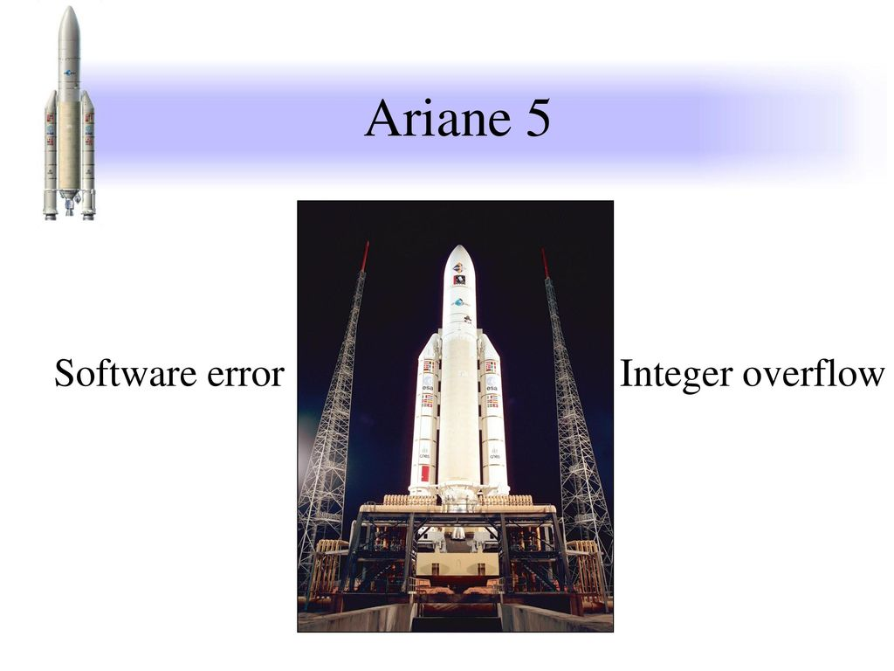

Ariane 5 space launch vehicle crash
Ariane 5's first test flight (Ariane 5 Flight 501) on 4 June 1996 failed, with the rocket self-destructing 37 seconds after launch because of a malfunction in the control software. A data conversion from 64-bit floating point value to 16-bit signed integer value to be stored in a variable caused a processor trap (operand error) because the floating point value was too large to be represented by a 16-bit signed integer.

Slide 4
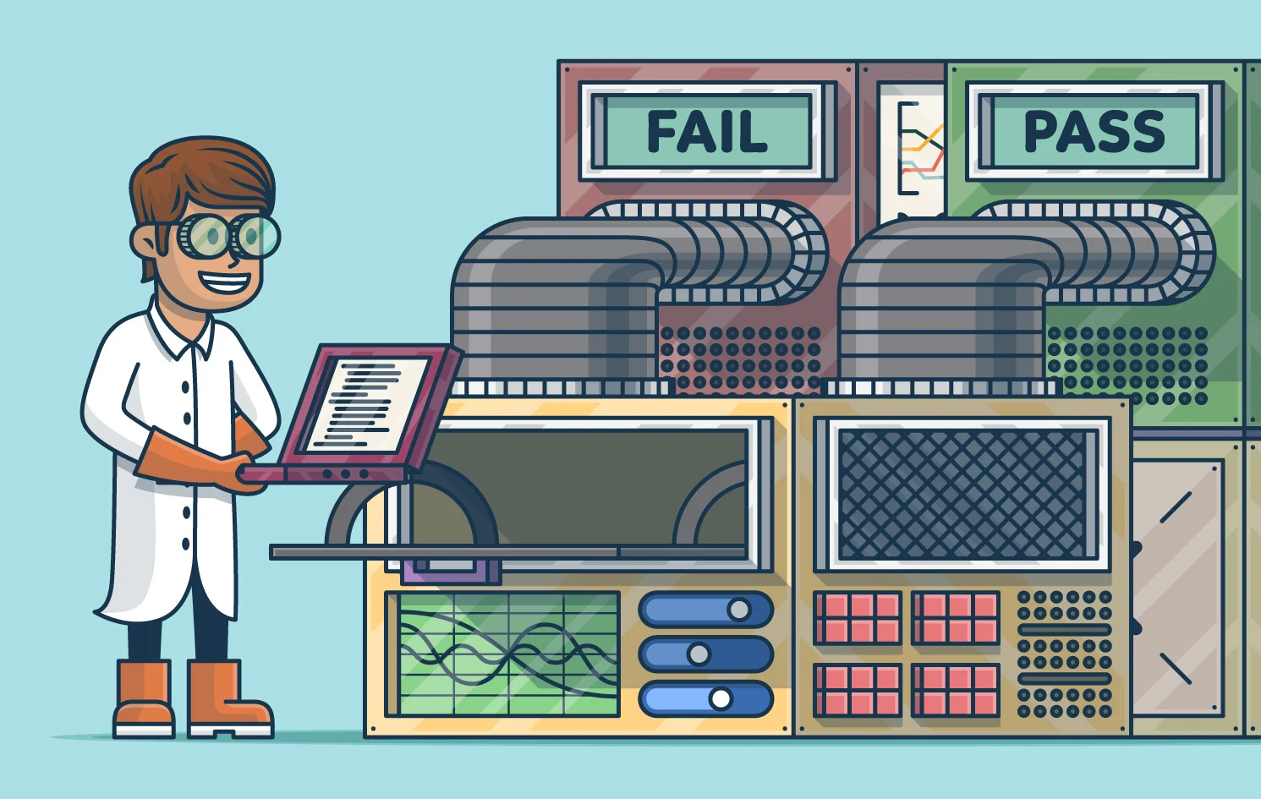
What is software testing?
Software testing is the process of checking that a software product or application does what it is supposed to do by detecting bugs in the software. Traditionally, software testing was performed in a later phase of software development life cycle, usually just before the software was going to be published. But it turns out that it cost a lot more efforts, money and time to fix the software in later phases of S.D.L.C as compared to the initial phases. Due to this, now a days, a practice called continuous testing is followed in which the testing starts just after the coding process starts. Fixing a piece of code initially is easier. Fresh code is usually very flexible. But as we go on adding more and more code into the software, we might reuse a lot of code in various places which makes it difficult to fix the problems later on. Thus, it is always better to start the testing process as soon as we can.

Slide 5
Classification
Manual Testing
Automation Testing
Manual testing includes testing software manually, i.e., without using any automation tool or any script. In this type, the tester takes over the role of an end-user and tests the software to identify any unexpected behaviour or bug. Testers use test plans, test cases, or test scenarios to test software to ensure the completeness of testing. Manual testing also includes exploratory testing, as testers explore the software to identify errors in it.
Automation testing, which is also known as Test Automation, is when the tester writes scripts and uses another software to test the product. This process involves the automation of a manual process. Automation Testing is used to re-run the test scenarios quickly and repeatedly, that were performed manually in manual testing. automation testing is also used to test the application from a load, performance, and stress point of view. It increases the test coverage, improves accuracy, and saves time and money when compared to manual testing.

Slide 6

Types of software testing
UNIT TESTING : It is used for validating that each software unit performs as expected. A unit is the smallest testable component of an application. It is often done by the programmer by using sample input and observing its corresponding outputs.
Unit testing cannot detect all the errors in the software. This is because when various components of the software work together and interface with each other, then there may arise errors. These are detected during integration testing and other types of testing.
Unit Testing is not efficient for checking the errors in the UI(User Interface) part of the module
Currently, there are a lot of various software (usually in the form of libraries) to perform automated Unit Testing such as:
1. Nunit ( Used especially in .NET software )
2. Junit ( For Java )
3. pyunit

Slide 7
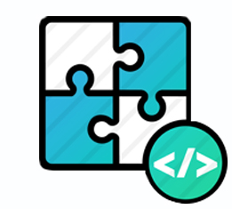
2. INTEGRATION TESTING
Integration testing is testing in which we usually test the combined functioning of multiple modules. It mainly tests the interface between two modules as the individual functioning is already tested in unit testing. We need to perform integration testing because :
A module may work perfectly in isolation but can have integration issues while interacting with another module.
In large teams where the modules are created by different developers or even teams, it becomes very necessary. As there can be a mismatch in the understanding of the different developers.

Slide 8

3. PERFORMANCE TESTING
In this we test the run-time performance of software within the context of an integrated system. It is used to test the speed and effectiveness of the program. It is also called load testing. In it we check, what is the performance of the system in the given load. It helps to measure stability under peak traffic events.
One of the popular tools used for performance testing of
Applications is Lighthouse utility from Google. It is included in
Almost all the chromium based browsers including Edge
and Chrome.

Slide 9

4. Acceptance Testing
Acceptance testing is done to check whether the delivered products perform the desired task according to customer or not, as stated in requirements. It has the following types:
1. User Acceptance Testing (UAT): User acceptance testing is used to determine whether the product is working for the user correctly. Specific requirements which are quite often used by the customers are primarily picked for the testing purpose. This is also termed as End-User Testing.
2. Beta Testing: Beta testing is used to assess the product by exposing it to the real end-users, usually called beta testers in their environment. Feedback is collected from the users and the defects are fixed. Also, this helps in enhancing the product to give a rich user experience.

Slide 10
Software Quality Assurance
Software Quality Assurance (SQA) is simply a way to assure quality in the software. It is the set of activities which ensure processes, procedures as well as standards are suitable for the project and implemented correctly. There are various activities, standards, and techniques that you need to follow to assure that the deliverable software is of high quality and aligns closely with the business needs. Software Quality Assurance is a process which works parallel to development of software. It focuses on improving the process of development of software so that problems can be prevented before they become a major issue. Software Quality Assurance is a kind of Umbrella activity that is applied throughout the software process.

Slide 11
Major Software Quality Assurance Activities
1. SQA Management Plan: Make a plan for how you will carry out the sqa through out the project. Think about which set of software engineering activities are the best for project. check level of SQA team skills.
2. Multi testing Strategy: Do not depend on a single testing approach. When you have a lot of testing approaches available use them.
3. Executing Formal Technical Reviews: FTR’s evaluate the design and quality of the product’s prototype. These reviews involve meeting with the technical staff to talk about the software’s actual quality requirements and the prototype’s design quality.
4. Auditing: This technique involves QA professionals inspecting the work to see if all standards are followed.
5. Maintain Reports and Records: Documentation is key to any quality assurance endeavor. Documentation includes audit results, change requests, test results, and review reports. The team should share this information with the stakeholders.

Slide 12
6. Keep Good Relations b/w QA team and Devs: Ensure that the QA team and the development team are cooperating and getting along. Often, these teams develop cliquish or superior attitudes, and that sort of behaviour must be discouraged.
7. Control Changes: This stage includes evaluating the nature of any changes, validating change requests, and controlling the effects of the changes. Designers use a combination of automated tools and manual procedures to control changes.
8. Support: Make sure that even after the software is deployed, if any customer faces issues in its usage or functioning, there must be a proper support system.
9. Simulation: Simulation models real-life conditions to virtually examine system behaviour.

Slide 13
Advantages of Software Quality Assurance
It saves time. According to some reports, it could take up to 150 times longer to fix an error in production than to fix that error in the design stage.
It boosts consumer confidence. You can spend so much time creating a good reputation, only to lose it overnight. Conversely, customers will flock to companies that are known for producing quality releases.
It cuts maintenance costs. Get the release right the first time, and your company can forget about it and move on to the next big thing. Release a product with chronic issues, and your business bogs down in a costly, time-consuming, never-ending cycle of repairs.

Slide 14
THANK YOU!

